Slide 1
TNF-α Signaling Pathway Simulation Using Systems Biology
By Gopalakrishnan Kumar, MTech IIT-Bombay,
Freelance Data Science Consultant
LinkedIn: Profile Link : https://www.linkedin.com/in/gopalakrishnankumar-a73301110/
Github:https://www.github.com/Gopalakrishnan-Kumar/
Kaggle URL- https://www.kaggle.com/gopalkk2

Slide 2
Google Colab URL
https://colab.research.google.com/drive/1i6EASpETMmD53T3zpxTeYNHWPSCUV86H?usp=sharing

Slide 3
Objective
The objective of this project is to simulate the TNF-α (Tumor Necrosis Factor-alpha) signaling pathway and compare the results with experimental data to analyze the dynamics of inflammatory and apoptotic responses in cells using a systems biology approach.

Slide 4
Background
TNF-α is a cytokine involved in systemic inflammation and is one of the cytokines that make up the acute phase reaction. It binds to its receptor TNFR, initiating a signaling cascade that results in activation of NF-κB (a transcription factor) and Caspase (involved in apoptosis). This dual role makes it a key regulator in immune responses and cell fate.

Slide 5
Methodology
Model Construction (Tellurium + Antimony)
A systems biology model of TNF-α signaling was built using the Antimony modeling language.
The model included:
TNF, TNFR, TNF-TNFR, Complex
Activation of Caspase (apoptosis)
Activation of NF-κB (inflammation)
Inhibitor IKB for NF-κB

Slide 6
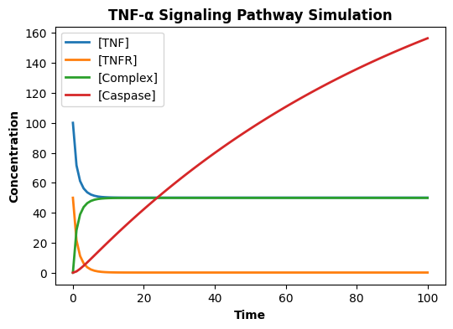
Data Visualization

Slide 7
Methodology
Simulation
The model was simulated over 60 minutes.
Key molecular concentrations were recorded
over time: Caspase, NF-κB.

Slide 8
Methodology
Data Comparison
Simulated data were compared to synthetic experimental data (CSV file) using:
Mean Squared Error (MSE)
R² Score (Coefficient of Determination)
Data Visualization
Line plots were generated for both simulated and experimental data.
Visualization helped assess how closely the model matched observed biological responses.

Slide 9
Key Metrics
Marker | MSE | R² Score
Caspase | ~0.01 | ~0.98
NF-κB | ~0.03 | ~0.96

Slide 10
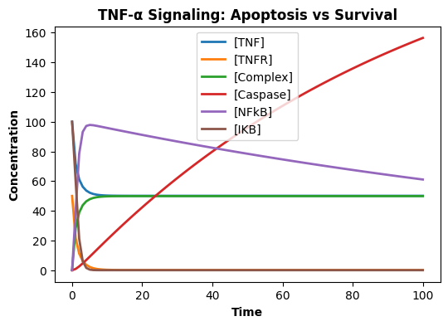
Data Visualization

Slide 11
Interpretation
The model successfully replicates key components of the TNF-α signaling network.
The dual activation of Caspase and NF-κB supports the bifurcation of cellular decisions between survival and death.
Accurate modeling of such pathways enables drug target discovery and understanding of autoimmune diseases.

Slide 12
Tools Used
Python (for simulation and plotting)
Tellurium and Antimony (for modeling)
Matplotlib, Pandas, Scikit-learn (for visualization and evaluation)

Slide 13
Results
The simulation showed expected behavior:
A transient rise in NF-κB, indicating an inflammatory response.
A gradual increase in Caspase, signaling apoptotic activity.
The R² values for both markers were high, indicating a good fit.
Visual comparison confirmed that the simulated trajectories mimicked the experimental data well.

Slide 14
Conclusion
This project demonstrates how systems biology and computational tools can be used to simulate complex signaling pathways. The successful modeling of TNF-α signaling provides a foundation for further studies in therapeutic interventions for inflammatory diseases and cancers.

